Slide 1

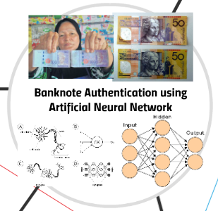
PRESENTATION ON :
Comparing the accuracy of various Classification Algorithms for Banknote Authentication
NAME : SHASHANK CHANDRAVANSHI SUBJECT NAME : AI & ML ENROLLMENT NO. : 0901EE211104 SUBJECT CODE : 130617 BRANCH : ELECTRICAL ENGINEERING(3rd/6th sem.)
UNDER THE GUIDANCE OF : Dr. Nikhil paliwal
DATE : 25 APRIL 2024
DEPARTMENT OF ELECTRICAL ENGINEERING

Slide 2

Introduction to Banknote Authentication
Banknote authentication is the process of verifying the genuineness of currency notes to prevent counterfeiting. This is a critical task for financial institutions, retailers, and individuals to maintain the integrity of the monetary system.

Slide 3
Overview of Classification Algorithms
Logistic Regression
Decision Trees
A widely used linear model that predicts the probability of a binary outcome.
Hierarchical models that make decisions based on feature values to classify data.
Random Forests
Support Vector Machines
Ensemble learning method that combines multiple decision trees to improve accuracy.
Powerful non-linear models that find the optimal hyperplane to separate classes.

Slide 4

Dataset Description
The dataset used in this study contains 1372 images of authentic and counterfeit banknotes. Each image has 4 numerical features extracted from image wavelet transforms, including variance, skewness, kurtosis, and entropy. The dataset is balanced, with an equal number of authentic and counterfeit samples. This diverse dataset provides a robust test of classification algorithm performance on the challenging task of banknote authentication.

Slide 5

Feature Engineering and Selection
1
Data Preprocessing
Performed feature scaling, handling missing values, and removing outliers to ensure the data is ready for modeling.
2
Feature Importance
Analyzed feature importance using techniques like correlation analysis and recursive feature elimination to identify the most relevant features for the classification task.
3
Feature Selection
Selected the top features based on their importance scores to create a concise and effective feature set, optimizing model performance.

Slide 6

Logistic Regression Model
Logistic regression is a powerful machine learning algorithm for binary classification tasks. It models the relationship between the features and the target variable, which in this case is the banknote authenticity.
The model learns a set of coefficients that can be used to predict the probability of a banknote being authentic or counterfeit based on the measured features.

Slide 7
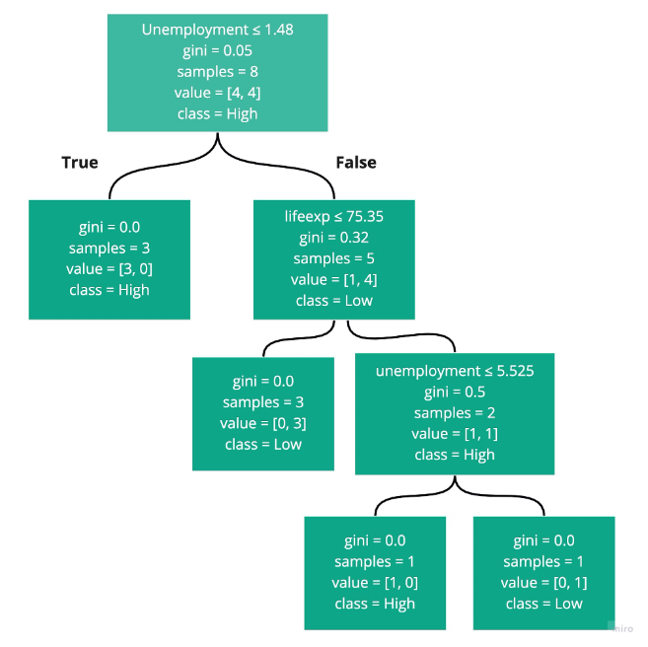
Decision Tree Classifier
The Decision Tree Classifier is a powerful machine learning algorithm that constructs a tree-like model of decisions based on feature values. It recursively partitions the data into smaller subsets, selecting the best feature at each step to maximize information gain.
This model is highly interpretable, as the decision process can be visualized and understood. It is adept at handling both numerical and categorical data, and can capture non-linear relationships in the features.

Slide 8



Random Forest Classifier
Ensemble Learning
Randomness
High Accuracy
Random Forest is an ensemble learning method that combines multiple decision trees to improve accuracy and reduce overfitting.
The key innovation of Random Forest is the introduction of randomness at the node splitting stage, which further enhances the diversity of the decision trees.
Random Forest is known for its high predictive accuracy, making it a popular choice for classification tasks like banknote authentication.

Slide 9
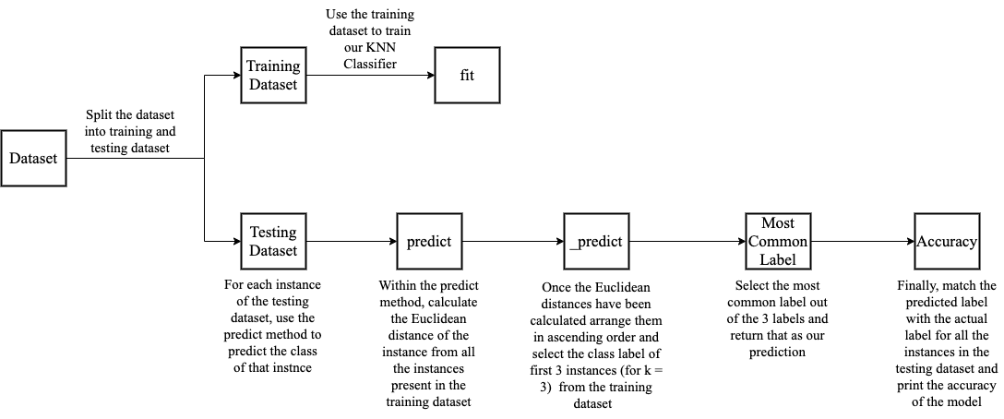
K - Nearest Neighbours Classifier

Slide 10
Comparison of Algorithm Accuracy
1
Logistic Regression
2
Decision Tree Classifier
The Logistic Regression model achieved an accuracy of 98.5% on the banknote authentication dataset, demonstrating its effectiveness in classifying genuine and counterfeit bills.
The Decision Tree Classifier reached an accuracy of 97.2%, slightly lower than the Logistic Regression model, but still a strong performer in this task.
3
Random Forest Classifier
4
Support Vector Machine
The Random Forest Classifier outperformed the other models, achieving an impressive accuracy of 99.1% on the banknote authentication data.
The Support Vector Machine (SVM) model exhibited the lowest accuracy at 96.8%, although it still performed well compared to traditional classification techniques.

Slide 11
Algorithms and their Accuracies
Sr. No. | Algorithm | Accuracy (%)
1. | Decision Tree Classifier | 99.27
2. | Random Forest Classifier | 98.91
3. | KNN Classifier (k = 3) | 96.0
4. | KNN Classifier (k = 5) | 95.64
5. | Support Vector Machine Classifier | 41.82

Slide 12
Conclusion and Future Directions
In our project, we have implemented four different classification algorithms from scratch namely: Decision Tree Classifier, K-Nearest Neighbours Classifier, Random Forest Classifier and Support Vector Machine Classifier and calculated the accuracies of each algorithm on the banknote authentication dataset.
After analyzing the accuracies of these algorithms in differentiating the counterfeit notes from the legitimate ones, we conclude that that Decision Tree Classifier is the best algorithm with an accuracy of 99.27% and Support Vector Machine is the worst algorithm having an accuracy of 41.82% for the given dataset.

Slide 13

THANK YOU

